Slide 1
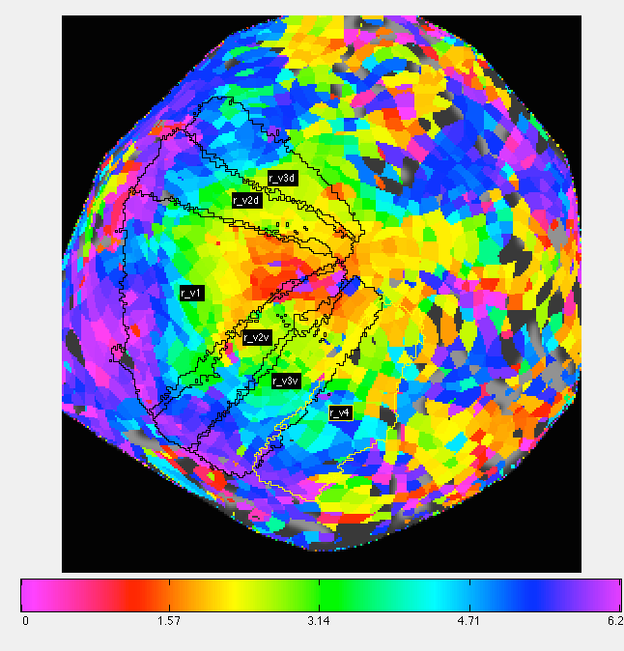
Crucial Parameters in PRF Models of Retinotopy
Daniel Birman
Psych 204b
15-03-10

Slide 3
Polar Angle
Eccentricity

Slide 5


Slide 6
V3a
V3a
V3d
V3d
V2d
V2d
V1
V1
V2v
V2v
V3v
V3v

Slide 7
Comparing the HDR

Slide 8
Comparing the HDR

Slide 9
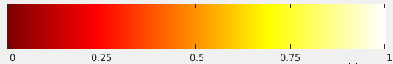

Slide 10
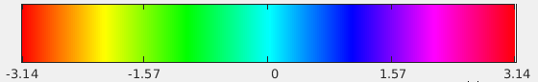

Slide 11
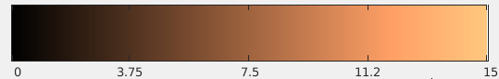

Slide 18
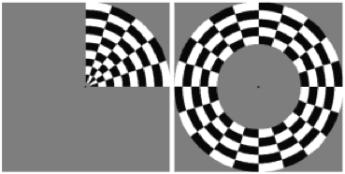

Importance of Stimulus Choice
6 Runs: 2 CW, 2CCW, 1 E, 1 C
4 Runs, each horz/vert/diag
http://www.neurobiography.info/images/teaching/retinotopy_stimuli.gif
http://gru.stanford.edu/lib/exe/fetch.php/mrtools/bars.gif?w=&h=&cache=cache

Slide 23
Estimating the pRF

